Slide 1
Final Project
Lydia

Slide 2
Lydia’s Website
Personal Portfolio

Slide 3
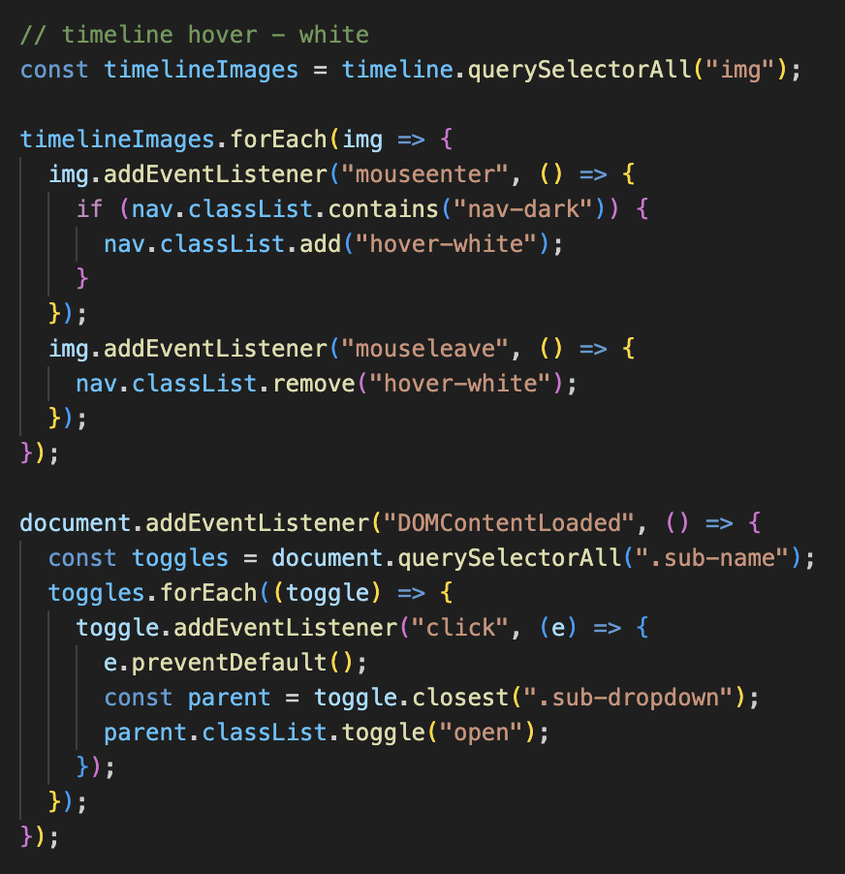
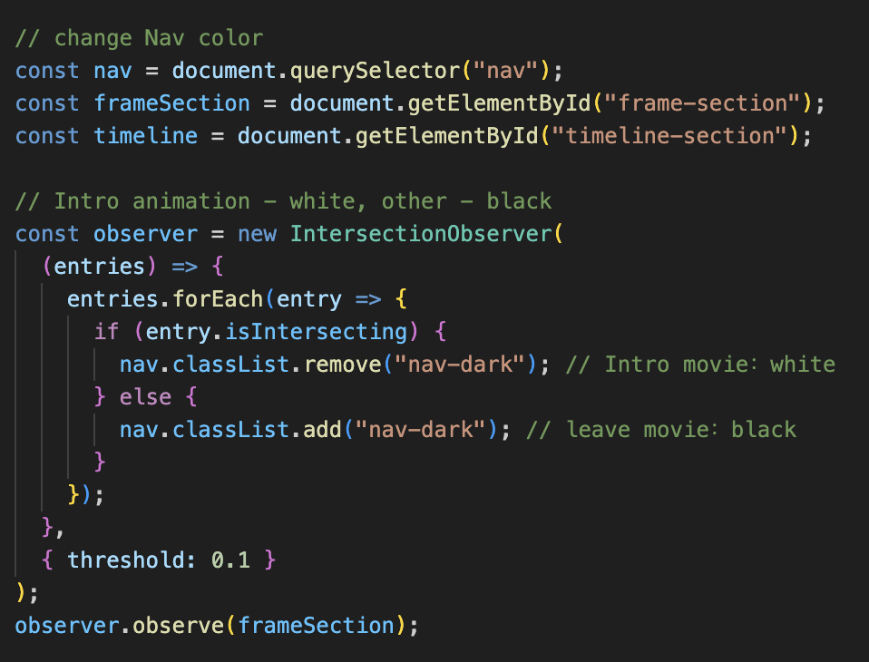
Show snippet of code
For Homepage and About page.

Slide 4
Functions to Add/Refine
Explore adding sound
Build more interaction into the timeline
Improve loading performance
Midterm：
(done) Footer with my social media links
(done) Hover effect on gallery artworks —— Show information on hover
(done) Navigation Enhancement: Dropdown for “Work”

Slide 5
Thanks for Watching
Lydia

